Slide 1
Healthy, Active and
Fit Kids –
It’s not an accident!
Focused Fitness
SEA 2015

Slide 2
Essential Question
How do you ensure that Quality PE
isn’t accidental in your district?

Slide 3
Epidemic of Physical Inactivity and Poor Nutrition
2015
1965

Slide 4
Results of Poor Health, Low Fitness and Inactivity
Sedentary Children Have 9 Times Poorer Motor Coordination
Inactive Children 63% More Likely to be Victims of Bullying
Six Hours a day of Inactivity = 4.8 Less Years of Life Expectancy
Related medical conditions cost our nation nearly $150 billion every year and account for 16 to 18 percent of our total healthcare costs (1 in every 6 dollars spent).
Projections estimate that by 2018 the cost the U.S. 21 percent of our total healthcare costs - $344 billion annually.
1 in 4 cannot serve in the military because of obesity
Of recruits who could not do 11 push-ups, 45 percent failed boot camp
Sources: PHIT America http://www.phitamerica.org/News_Archive/10_Doctors_Weigh_In_Issues.htm#sthash.aaIxrtIu.dpuf,
President’s Council on Physical Fitness and Sport
and Too Fat to Fight- Lt. General Mark Hertling

Slide 6
Solution: Physical Education without enough Quality will not end childhood inactivity and obesity.

Slide 7
Essential Question
What does Quality PE mean to you?

Slide 8
The Science and
Art of Quality PE

Slide 9
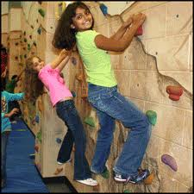
The Science of Quality PE
1. Standards Based- Required by law to teach
Four content areas: Academic, Fitness, Motor Skills, Social/Emotional
Operational curriculum of the program is defined
Mapped and articulated content K-12
Identifies the essential content
that is non-negotiable

Slide 10
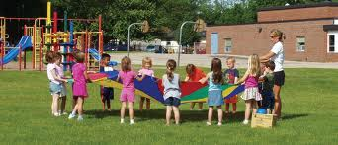
The Science of Quality PE
2. Measurable Objectives
Clearly defined objectives within all lessons
Shared with students – reveal the learning to students
Objectives are aligned to standards and non-negotiable content
Multiple opportunities for students to meet objectives

Slide 11
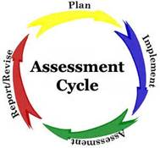
The Science of Quality PE
3. Common Assessment Plan
Based on standards
Include all four content areas
Part of accountability system
for students and teachers
Formative and summative
Understand student growth and
program outcomes
Validates PE program

Slide 12
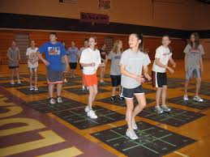
The Art of Quality PE
1. Comprehensive lessons
Aligned with standards
Integrating all four content areas (Academic, Fitness, Motor Skills and Social/Emotional)
Appropriate lesson structure
Warm-up/Instant Activity
Lesson Focus
Cool-down/Closure

Slide 13
The Art of Quality PE
2. Maximizing Moderate to Vigorous Physical Activity (MVPA) for at least 50% of class time
Well planned lesson
Instant activities to get kids moving
Small sided games
Quick grouping strategies
Short instructional segments

Slide 14
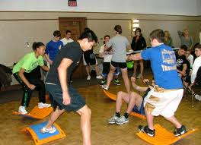
The Art of Quality PE
3. Motivating and engaging for ALL students
Differentiated instruction
Fun and relevant activities
Student choice
Equipment
Activities
Grouping
Environment is respectful
Students feel comfortable trying new activities

Slide 15
The Art of Quality PE
4. Track progress, both individually and for the group
Build in accountability
Individualized goal setting for students
Understand what students know and can do
Define student growth – what do you want students to achieve?

Slide 16
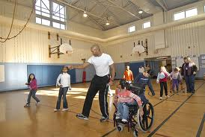
The Art of Quality PE
5. Developmentally appropriate activities
Appropriate in all four content areas (Academic, Fitness, Motor Skills and Social/Emotional)
Activities are appropriate for skill level of students
Skills should be introduced in defined progression

Slide 17
An example of blending the science and art of QPE through activity

Slide 18
How can we change the tide to incorporate more Quality PE into our programs?

Slide 19
Diffusion of Innovations Theory
This is a theory that seeks to explain how, why and at what rate new ideas spread through systems
Reinvention is the key principle in the theory
5 years is the average time for a reinvention to take hold or be easily measured
Rate of adoption is the relative speed with which an innovation is adopted by members of a social system

Slide 20
The Wave of Selling a Disruptive Idea- Quality Physical Education
Rogers, Everett (1962), Diffusions of Innovations Theory

Slide 21
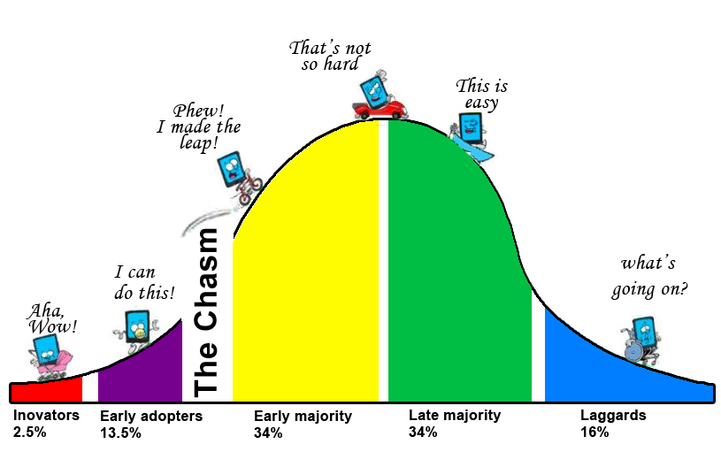
How are you selling the disruptive idea of QPE in your district?

Slide 22
Key indicators in selling a disruptive idea.
Which segments of your organization would you focus on?
How would you empower them to be influential?
What would be a way for you to create proof of the benefit of the idea?
Are you mapping who is changing and what segment they belong to - does this indicate the success of your leadership?
The wave of selling a disruptive idea is an illustration for innovative leaders who need to garner buy-in for a new direction (QPE), to a critical audience.

Slide 23
QUALITY PE disrupts the
100 year curriculum model !
Where are you on the innovation scale?

Slide 24
Thank You!
www.focusedfitness.org

